Slide 1
General announcements

Slide 2
Goalless Problem
For a goalless problem, your job is to analyze a situation using the concepts, equations and skills you have developed so far in an open-ended setting. Using blurbs, equations, sketches, graphs, whatever, to support your thinking, the idea is to identify and quantify everything you can about the situation you are examining.

Slide 3
Goalless Problem
Problem B.) A small block of mass m = 0.50 kg is fired along a horizontal track. It’s initial velocity is . The block then enters and slides along the vertical, frictionless, semicircular track of radius R = 1.5 m (through point A toward point B), until it reaches the level bottom portion of the track. A small section of length L = 0.40 m provides a frictional force of 0.83 N before the track becomes frictionless again and the object slides toward point C.

Slide 4
What’s the patch’s coefficient of friction?
What kind of questions might you ask of this problem?
How fast is the mass moving when at A? at B? as it leaves the frictional patch?
What’s the mass’s acc at A? at B?
What is the mass’s acceleration through the frictional patch?
How does the normal force on the mass’s compare between A and B?
How much energy did gravity contribute to the system as the mass “fell” from the top to the bottom level?
How long did it take the mass to “fall” from the top to the bottom level?
How much impulse did the friction provide to the mass?
How long was the impulse provide?
What was the mass’s momentum after leaving the frictional patch?
Does the mass get to point C?
Graphical representation of mass’s velocity around loop? It’s kinetic energy? It’s potential energy? It’s total energy?

Slide 5
Ground Rules for Block Day Exercise
Start by reading the question – what’s going on in the situation? What are the initial conditions given? What, conceptually, will the object do as it moves? Map out different segments of the problem, and whether there are places where you can ask, “Will the object…?”
Pick somewhere to start (probably the initial conditions) and consider options from each unit. For example, if you think you need to figure out an object’s acceleration, you could consider:
-drawing an FBD and using Newton’s 2nd Law to solve for acceleration
-using a kinematic equation and information about velocity, time, and/or displacement
-using Conservation of Energy to find a new velocity and then using a kinematic eqn.
…or do all three! Another point of goalless problems is to use multiple methods to check your work, so if you calculate something using kinematics, you can always check your answer using energy, etc. etc. That shows two different approaches to find the same value, which is an important skill.

Slide 6
Try to use concepts from all the units we’ve done this year. This can include equations, graphs, diagrams (e.g. FBDs), or brief conceptual explanations. Not every problem will require every single topic (for example, one problem might have centripetal motion but another might not) but every single one will have at least one thing that can be drawn from kinematics (1D and/or projectiles), Newton’s Laws, energy, and momentum. You will not see rotational motion stuff, as we will have just taken our unit test on that topic.
BLURB BLURB BLURB! Give a brief blurb to show what you’re solving for at any particular time, or whether you’re comparing two answers, or whether you’re trying to see what an object will do (e.g. will it stop before getting to the table’s edge or slide over the falls?), etc. Be organized and use as much space as you need.
There is no “right” answer to any of these problems – we will be looking to see you demonstrate both your conceptual understanding (what is sensible to solve for? What is the object going to do once it starts moving through the set-up described?) and your ability to correctly manipulate equations from each unit. We aren’t looking for a set number of answers. There’s no pre-set “quota”!
Finally, remember that the point of these problems is to think like a scientist: See a situation with some observable information and then consider “what can I find out from this? What might be interesting to know about this motion? How can I represent what’s happening using graphs and equations?”

Slide 7
Goalless Problem
For a goalless problem, your job is to analyze the situation using the concepts, equations and skills you have developed so far in an open-ended setting. Using blurbs, equations, sketches, graphs, whatever, to support your thinking, the idea is to identify and quantify everything you can about the situation you are examining.
Problem 2.) A 0.2 kg salt shaker starts from rest at the edge of a 2.1 m long table and is pushed with a constant 2.0 N force until it reaches a speed of 1.01 m/s. The frictional force during the push is 0.05 N. As soon as the shaker reaches the 1.01 m/s speed, the pushing force ceases.

Slide 8
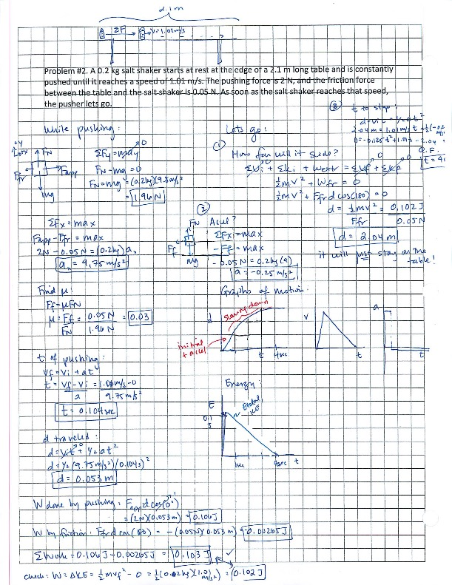

Slide 10
Problem 2.) A 0.2 kg salt shaker starts from rest at the edge of a 2.1 m long table and is pushed with a constant 2.0 N force until it reaches a speed of 1.01 m/s. The frictional force during the push is 0.05 N. As soon as the shaker reaches the 1.01 m/s speed, the pushing force ceases.
How could we have made the problem a little more interesting?
The table length could have been made such that the shaker didn’t stop before getting to the table’s end.
In that case, knowing the table’s height would have opened up a whole other set of problems.
Or we could have added in a spring . . .

Slide 11
Goalless Problem
Again, your job is to analyze the situation using the concepts, equations and skills you have developed so far in an open-ended setting. Using blurbs, equations, sketches, graphs, whatever, to support your thinking, the idea is to identify and quantify everything you can about the situation you are examining.
Problem 1.) An 80 kg box starts from rest and travels to the bottom of a 2.0 meter long, ramp, opposed by a constant 150 N frictional force.

Slide 12
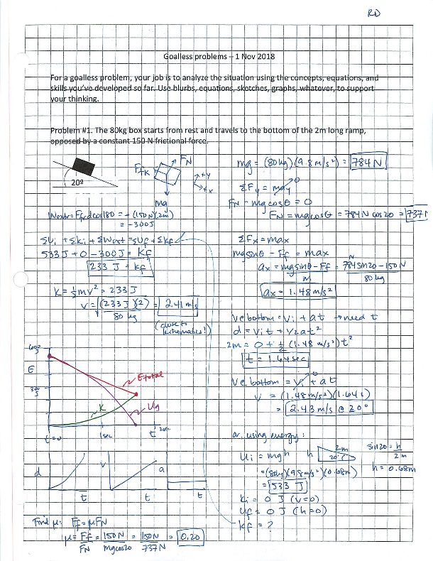

Slide 14
Goalless Problem
Again, your job is to analyze the situation using the concepts, equations and skills you have developed so far in an open-ended setting. Using blurbs, equations, sketches, graphs, whatever, to support your thinking, the idea is to identify and quantify everything you can about the situation you are examining.
3.) An 80 kg box starts from rest and travels to the bottom of a 2.0 meter long, ramp, opposed by a constant 150 N frictional force.

